Slide 1

“Assessment of direct cost of cerebral palsy management and its effects on family, Bangladesh perspective”
A dissertation submitted by:
ASMA AKTER ,
ID: 191- 0044-011
University of South Asia ,Department Of Public Health
Supervisor : Sajia Afrin, Faculty member, Department Of Public Health , University of South Asia

Slide 2
Introduction
Cerebral Palsy is a long-term chronic medical condition that requires long-term supportive care services. Those with Cerebral Palsy often have other associative and co-mitigating medical conditions, including cognitive challenges, vision loss, hearing impairment, and seizures. These conditions require diagnosis, treatment and maintenance - all at significant cost. Cost of Cerebral Palsy (CP) has a negative impact on family which has a negative effect on the management of CP children that ultimately increases the cost again .
The cost of care for children with CP in this study, when considered by the economic situations during the study, was high. However, we took 3 months direct cost for the management of CP. the total annual cost when compared with what was reported from developed countries shows that our figure was much lower when compared to the cost of raising a child with CP from the USA, the UK, and the Netherlands (Beecham et al., 2001; Hoving et al., 2007). This could possibly be explained by the unavailability of cost-intensive diagnostic tools for CP, sophisticated medical therapy, and other long-term supportive services in this part of the world (Umar et al., 2020)

Slide 3
Justification
In our country we have not enough study on the cost of CP or other disability. According to the Bangladesh Bureau of Statistics (BBS) estimated that 1.6 per cent of the country’s population suffers from disabilities. Action Aid Bangladesh estimated that 8.8 per cent of people (in 1996) require disability related services.
In countries like Bangladesh it might cause more burden on the family and Countries economy.
Effect due to the treatment cost that we mentioned here might also have negative impact that was described by the family members or parents of CP children in our regular practice. In this small study we try to find out the cost and its impact on the family due to this cost.

Slide 4
Research Question?
How much a family needs to spend ( direct cost) for the treatment of CP and its effects on family?
Study objectives:
Objectives:
General:
to know the cost of CP management or treatment and how it affects the lifestyle or livelihood to the other family members .
Specific:
To know the cost (direct) of CP treatment.
How family gets affected because of this cost?
For the benefit of the further research

Slide 5
Conceptual Framework
Independent Variables
Outcome Variables
Age
Gender of the child
Residence or the child
parents/ respondents education
Cost and its Effects due to the cost
Income of parents
Frequency of illness
Domain affected

Slide 6
Methodology
Study design: a cross sectional study.
Population size Calculations
Sampling procedure for cross section study done by following equation-
n=z2pq/ d2, n=z2pq/ d2
Here,
P=50%
q=-0.05%
n= (1.96)2×0.5×0.5×(0.05)2
=384.16
but due to time limitation and corona situation sample size needed to reduce at 41, as a feasible sample size.
sampling technique : purposive sampling technique,
Participants and study area: participants from the whole country who will come to receive treatment at Dr. MR Khan shishu Hospital.
Study period: 4 months.

Slide 7
Methodology: continue
Inclusion criteria:
Parents of CP children.
Who are willing to participate?
Exclusion criteria:
Parents of CP who are not interested
Parents of others disability.
Data Collection:
Face to Face Interview technique was applied to collect data form the parents or respondent.
Data was documented on a written designed semi structured questionnaire
Data Analysis:
collected data were administered and analyzed using SPSS statistical software version 20 and results presented in form of tables, pie charts and Bar graphs..

Slide 8
Ethical Considerations:-
❖ Informed consent was taken before the data collection from the respondents.
❖ Confidentiality and privacy was maintained throughout the study.
❖ Any participant was at liberty to refuse to participate in the study or withdraw from it.
Limitations of the study:-
Due to corona situation we have collected data from one organization instead of three .
sample size needed to reduce due to COVID-19. .
Most of the population were almost from a certain socioeconomic condition, so we did not know the cost and effect with other socioeconomic condition.

Slide 9
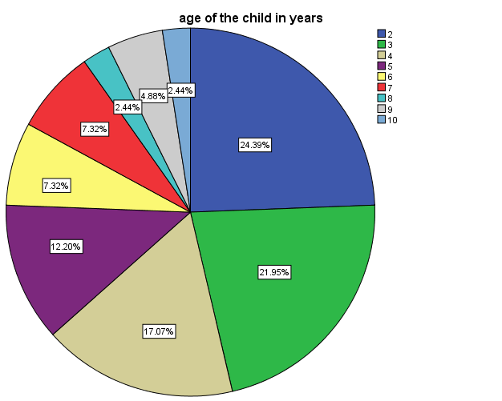
Result
Figure 1: Distribution of children with cerebral palsy based on age (n=41)
Pie chart represents the percentage of age of 41 children with cerebral palsy. Among 41 children, a large number 24.39% were 2 years old, 21.95% were 3 years old, and 17.07% at 4 years, 12.20 were 5 years old. And the rest were among 6-10 years old.

Slide 10
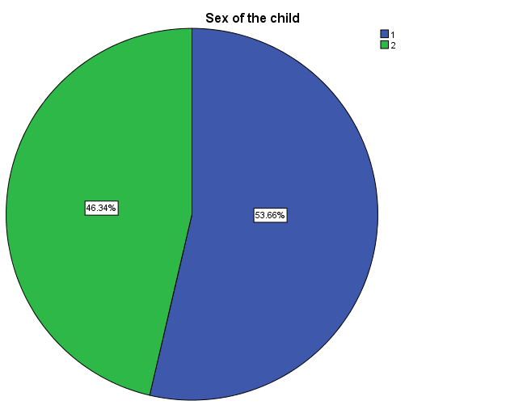
Figure 2 : Distribution of children with cerebral palsy based on sex (n=41)
Figure 2 : represents the percentage of 41 children with cerebral palsy. Among 41 children, a large number 53.7% (n=22) were male and a small number of children 46.3% (n=19) were female.

Slide 11
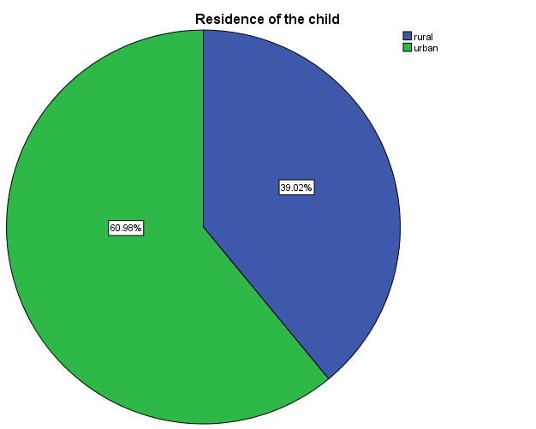
Figure 3 : Distribution of children with cerebral palsy based on Residence (n=41)
Figure 3 : Represents the percentage of residence 41 children with cerebral palsy. Among 41 children, a large number 61.0% (n=25) came from urban areas and a small number of children 39.0% (n=16) were came from rural areas.

Slide 12
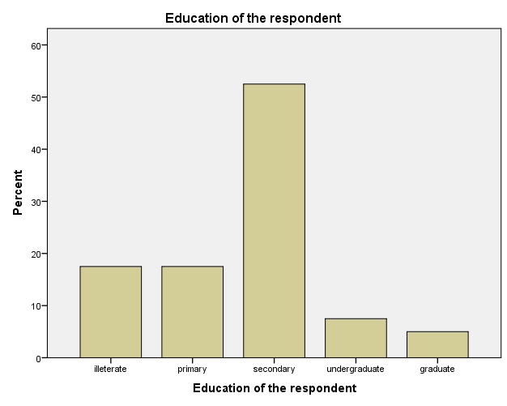
Bar chart: Distribution of the respondent’s education (n=41)
Bar chart represents the percentage of educational level of the respondents of the cerebral palsy children. Most of the respondents were mother and mong 41 respondents, Above 50% is with secondary education status, illiterate and primary education status almost at the same percentage, and less number of respondents are graduate and undergraduate level. In simple, large number 63.4% (n=26) have respondents with secondary or higher education status and a small number of children 36.6% (n=15) of children have respondents with below secondary educational status.

Slide 13
Table 1: Distribution of cost type with children with cerebral palsy (n=36) in the last 3 months:
Cost Type | Mean | SD | Min | Max
Direct cost(medical)
Doctors Consultation Fee | 967.07 | 925.99 | 0 | 5000
Admission fee | 3785.37 | 8829.40 | 0 | 50000
Medicine cost | 7842.93 | 38805.50 | 0 | 250000
Test / diagnostic fee | 5223.17 | 10981.87 | 0 | 64000
Rehabilitation services (like physiotherapy, occupational therapy, speech therapy, counselling, nutritional counselling etc.) | 1708.54 | 3018.44 | 0 | 19000
Cost for Assisted Devices | 2017.07 | 3252.43 | 0 | 15000
Direct cost (non-medical but treatment related)
Food and transport cost | 3259.76 | 6353.69 | 100 | 35000
Others cost | 1121.95 | 1286.37 | 0 | 5000
Total cost | 25925.85 | 52619.24 | 150 | 335950
Based on Table 1, direct medicine costs are the highest burden (11521.54 BDT) of the children aged 0-4 years, over the all types of cost. Rather than medicine cost, on average, families of 0-4 years of children with CP spend highest 7138.46 for direct test/diagnostic costs. Followed by, 4773.08 BDT for admission costs, 4215.38 for indirect food and transport costs. However, children age greater than 4 years families had to spend highest (2846.67 BDT) direct cost for assisted devices.

Slide 14
Table 2: Mean difference of total cost by condition of children with cerebral palsy
 | n (%) | Total cost |  | P-Value
 |  | Mean | SD
Frequency of illness
No illness | 9 (22.0) | 6477.78 | 3659.76 | .085
One times | 15 (36.6) | 20260.00 | 20791.64
Two times | 10 (24.4) | 20860.00 | 17388.02
Three times | 7 (17.1) | 70307.14 | 118280.08
Limb involvement
Monoplegic | 3 (7.3) | 10583.33 | 5385.24 | 0.791
Hemiplegic | 18 (43.9) | 20761.67 | 20310.78
Diaplegic | 1 (2.4) | 3800.00 | -
Quadriplegic | 19 (46.3) | 34405.26 | 74773.19
Domain affected
Less than two | 5 (12.2) | 15540.00 | 19972.56 | 0.381
Two | 6 (14.6) | 7875.00 | 1835.14
Three | 10 (24.4) | 12370.00 | 10032.81
Greater than three | 20 (48.8) | 40715.50 | 72375.63
Total | 41 (100) | 25925.85 | 52619.24
Table 2: represents the percentage of 41 children with cerebral palsy. Among 41 children, a large number of children 36.6% (n=15) were face illness one times in last three months and the mean cost for treatment was 208600 BDT. However, the mean cost was highest for children face illness with three times in last three months.
Among 41 children, a large number of children 46.3% (n=19) were Quadriplegic and the mean cost for treatment was highest (34405.26 BDT) among all other limb involvement.
Among 41 children, a large number of children 48.8% (n=20) domain affected greater than three and the mean cost for treatment was highest (40715. BDT) .

Slide 15
Table 3: Comparison of CP economic burden according to age group of the CP child
Cost Type | 0-4 years old | 4+ years old | P-value
Direct cost(medical)
Doctors Consultation Fee | 1011.54 | 890.00 | 0.691
Admission fee | 4773.08 | 2073.33 | 0.352
Medicine cost | 11521.54 | 1466.67 | 0.431
Test / diagnostic fee | 7138.46 | 1903.33 | 0.144
Rehabilitation Services | 1446.15 | 2163.33 | 0.471
Cost for Assisted Devices | 1538.46 | 2846.67 | 0.219
Direct cost (non-medical but treatment related)
Food and transport cost | 4215.38 | 1603.33 | 0.209
Others cost | 1084.62 | 1186.67 | 0.810
Based on Table 3, direct medicine costs are the highest burden (11521.54 BDT) of the children aged 0-4 years, over the all types of cost. Rather than medicine cost, on average, families of 0-4 years of children with CP spend highest 7138.46 for direct test/diagnostic costs. Followed by, 4773.08 BDT for admission costs, 4215.38 for indirect food and transport costs. However, children age greater than 4 years families spend highest (2846.67 BDT) for direct cost for assisted devices.

Slide 16
Table 4: Comparison of CP economic burden according to education of mother (respondents)
Cost Type | Below secondary | Secondary or higher
Direct cost(medical)
Doctors Consultation Fee | 830.00 | 1046.15
Admission fee | 1633.33 | 5026.92
Medicine cost | 1506.67 | 11498.46
Test / diagnostic fee | 2136.67 | 7003.85
Rehabilitation Services | 2140.00 | 1459.62
Cost for Assisted Devices | 2300.00 | 1853.85
Direct cost (non-medical but treatment related)
Food and transport cost | 1950.00 | 4015.38
Others cost | 986.67 | 1200.00
Based on Table4 ,
below secondary respondents spend more money on assisted device (2300.00 BDT) and less on doctors consultation. Whereas more educated or above secondary mother spend more on buying medicine(highest) and test that is (11498.46 BDT) , and (7003.45 BDT) . Interestingly we notice that with higher education cost also increased.

Slide 17
Table 5: Effects on family due to the cost of CP treatment (N=41)
Variable | percent | Frequency
1Effects on treatment of the other family members Does not do anything/ no treatment Visit a quack Went to a doctor and get proper treatment home remedy or traditional treatment | 39 53.7 39.5 10.5 | 16 22 16 6
2.Effects on Income of the family members( mainly father and mother) Due to frequent visit to doctors Due to take care of the child | 41.5 14.6 | 17 18
3.Effects on Education of the other children Late school fee Effects on tuition fee Withdrawn from school | 19.5 34.1 0 | 8 14 0
Table 5 shows that above 50 percent of told they went to a doctor and received proper treatment, 39 percent said that they did not take any treatment to save money .
41.5 percent said that they had to compromise with their income as the CP child needs frequent visit to doctor.
34 percent parent cannot afford tutor for their other children to save money for the CP child. No child had to leave school

Slide 18
Effects on family due to the cost of CP treatment (N=41), continue
4.Effects on food for the family member Reduce the number of meal Reduce number of good food Reduce number of favorite food | 31.7 56.1 61 | 13 23 25
5. effects on entertainment of the family member Attending social program Visiting family members and relatives/tour Children amassment like go to park, zoo etc. | 48.8 46.3 29.3 | 20 19 12
61 percent family needs to cut off their favorite food to save the money for the treatment of CP child.
48 percent told that they usually try to save money by avoiding social program.

Slide 19
Table 6: Association between effects in the family due to the treatment cost of children with cerebral palsy with socio-economic characteristics
 | Effect |  | P-Value
Age in months | Low | High
0-4 | 11 (42.3) | 15 (57.7) | 0.281
4+ | 4 (26.7) | 11 (73.3)
Sex of child
Male | 9 (40.9) | 13 (59.1) | 0.536
Female | 6 (31.6) | 13 (68.4)
Place of residence
Rural | 5 (31.3) | 11 (68.8) | 0.209
Urban | 10 (40.0) | 15 (60.0)
Father’s Income
Below 20000 | 10 (33.3) | 20 (66.7) | 0.067
20000+ | 5 (45.5) | 6 (54.5)
Mother’s Age
15-30 | 6 (25.0) | 18 (75.0) | 0.272
30+ | 9 (52.9) | 8 (47.1)
Respondents education
Below secondary | 6 (40.0) | 9 (60.0) | 0.730
Secondary or higher | 9 (34.6) | 17 (65.4)

Slide 20
Discussion:
Based on the information obtained from interviews with 41 CP patients’ caregivers in Bangladesh, from the societal perspective, the total lifespan economic burden caused by a new CP case mean was BDT 25925.85 in 2020. The economic burden is heavy both for the family and society. There are several factors which contribute to this high economic burden, such as long-life expectancy, life-long and high dependency on caregivers’ support, progressive deterioration of motor function, and recurrent use of rehabilitation services.
Our study showed that transport and lodging costs spent during each clinic visit were quite insignificant as most of the patients reside within the metropolis. There is no significant difference in the average cost per patient per month across gender, age group, type of CP, and number of associated problems. By socio-demographic characteristics, our study showed that the majority of the patients in the study belong to certain socioeconomic classes (within 50000 taka per month) in a resource-challenged setting. This finding is consistent with the previous association of CP with poor education and poverty (Eide et al., 2014; Odding et al., 2006). Furthermore, our finding is similar to previous reports from developing countries (Frank-Briggs & Alikor, 2011; Singhi et al., 2002).

Slide 21
Conclusions
Understanding of the economic impact of CP can assist decision makers in their day-to-day decisions. The applicability of the economic impact research findings would be greatly enhanced through greater consistency of reporting methods across studies. Although analysis techniques and cost components employed in the included studies were varied, the results showed a strong positive relationship between CP severity and costs. Costs covered substantial expenditure related to medical services, costs borne by families, as well as the welfare system to facilitate social participation and engagement. The results also confirm that research to identify useful and cost-effective interventions is warranted to optimize expenditure related to CP care.

Slide 22
Acknowledgement
All praise and gratitude goes to "Almighty Allah" the most gracious and merciful, who gives me the energy to endure the rigorous of tedious job.
I wish to express my special gratitude to our Honorary Dean sir Professor Dr.Hasan Shahid Suhrawardy School of Public Health, University of south Asia .
I wish to express my hurtful thanks to my supervisor Mst Sajia Afrin her thoughtful supervision, valuable advice and continuous encouragement from the beginning of this study.
I am thankful to my respectable course Co-ordinator Dr.Manik Chandro Das for his valuable advice, guidance and help throughout the study.
I also thanks to all of my classmates and for their kind cooperation in every stages of the thesis work.
I would like to thank my beloved parents and my children and family members for their support during my dissertation.

Slide 23
References
Beecham, J., O’Neill, T., & Goodman, R. (2001). Supporting young adults with hemiplegia: Services and costs. Health and Social Care in the Community, 9(1), 51–59. https://doi.org/10.1046/j.1365-2524.2001.00279.x
Eide, A. H., Khupe, W., & Mannan, H. (2014). Development process in Africa: Poverty, politics and indigenous knowledge. African Journal of Disability, 3(2). https://doi.org/10.4102/ajod.v3i2.75
Frank-Briggs, A., & Alikor, E. (2011). Sociocultural issues and causes of cerebral palsy in Port Harcourt, Nigeria. Nigerian Journal of Paediatrics, 38(3), 115–119. https://doi.org/10.4314/njp.v38i3.72266
Hoving, M. A., Evers, S. M. A. A., Ament, A. J. H. A., van Raak, E. P. M., & Vles, J. S. H. (2007). ‘Intractable spastic cerebral palsy in children: a Dutch cost of illness study.’ Developmental Medicine & Child Neurology, 49(5), 397–398. https://doi.org/10.1111/j.1469-8749.2007.00397.x
Kancherla, V., Amendah, D. D., Grosse, S. D., Yeargin-Allsopp, M., & Van Naarden Braun, K. (2012). Medical expenditures attributable to cerebral palsy and intellectual disability among Medicaid-enrolled children. Research in Developmental Disabilities, 33(3), 832–840. https://doi.org/10.1016/j.ridd.2011.12.001
Kruse, M., Michelsen, S. I., Flachs, E. M., Brønnum-Hansen, H., Madsen, M., & Uldall, P. (2009). Lifetime costs of cerebral palsy. Developmental Medicine and Child Neurology, 51(8), 622–628. https://doi.org/10.1111/j.1469-8749.2008.03190.x
disability among Medicaid-enrolled children. Research in Developmental Disabilities 2012; 33(3):832-840.

